Slide 1

Exploring Azure Data Services
Cosmos DB / Data Lake / Data Factory

Slide 2

Presenters
Grant Harmer
Solution Architect ^{(DRC)}
> 5 years
Southern Cross Healthcare, IAG, BNZ
Grew up in the usual way from software developer
Been working in the cloud for about year
Saying you’re cloud ready – it’s not enough
At least a 6 month journey
Get your hands dirty
A desired outcome is the best result, an undesired outcome is a poor result, but the worst outcome is to never try. Fail Fast, Learn Fast.

Slide 3
Agenda
Techie / Marketing Blurb
Cosmos DB
Data Lake
Date Factory
Demo
Problem
Solution
Questions

Slide 4
Techie / Marketing Blurb

Slide 5
Cosmos DB
https://azure.microsoft.com/en-us/services/cosmos-db/

Slide 6
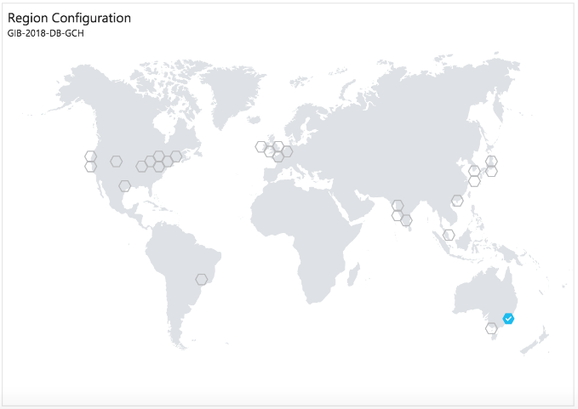
Cosmos DB
Database Service
Globally Distributed
Limitless Elastic Scale
Low Latency
Multi-model
table
document
graph
Document
SQL Server
MongoDB
Cassandra
Graph
Gremlin
Language Support
.Net (full & Core)
Java
JavaScript
Node.js
<others>

Slide 7
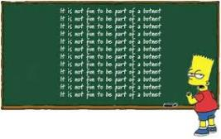
Cosmos DB
SQL API - Lessons
Collections
Each is Charged by:
Capacity (GB)
Throughput (RU’s)
Multiple object Types per Collection
Collection ≠ Table
Dates are stored as strings
Filtering is a problem
Epoch values
Performance
Pre-allocate Throughput (RU’s)
No auto-scale
Throughput to support API scale-out
Costs
Finding the right Throughput
Trial and Error

Slide 8
Cosmos DB
SQL API - Lessons
Change Feed
listening to a collection for changes
ordered list
queue per consumer
?all models?
https://docs.microsoft.com/en-us/azure/cosmos-db/change-feed

Slide 9
Data Lake
https://azure.microsoft.com/en-us/services/data-lake-analytics/
https://azure.microsoft.com/en-us/services/data-lake-store/

Slide 10
Data Lake
Store
Petabyte-size files
Trillions of objects
Any type of data
massive datasets
high-resolution video
genomic and seismic datasets
medical data
JSON
TXT / CSV
Analytics
Data transformation
Trillions of objects
Massively Parallel
Processing langauages
U-SQL
R
Python
.Net

Slide 11
Data Lake
Store
Cost Effective
File system
Folder hierarchy
Getting the layout right
business purpose
reduce analytics waste
e.g. time-series data
Analytics
Cost - Analytics Units:
degree of parallelism
duration
Reduce waste
source data layout / filters
parallelism - trial and error

Slide 12
Data Lake
Analytics - Parallelism vs. Time
waste
parallelism
vs.
6 time units
8 time units
10 units of waste
Cost = 4 * 6 = 24
2 units of waste
Cost = 2 * 8 = 16

Slide 13
Data Factory
https://azure.microsoft.com/en-us/services/data-factory/

Slide 14
Data Factory
Integration / ETL
Ingest and prepare
Transform and analyse
Publish and consume
Scheduler
On-premises or cloud
Cosmos DB
Data Lake Store
REST
+more
https://azure.microsoft.com/en-us/services/data-factory/

Slide 15
Demo

Slide 16
Demo
Information Viewpoint
Customer
Order
Product

Slide 17
Demo
Information Viewpoint
Customer | Order | Product
{ "@context": "http://gib2018.org", "@type": "Customer", "id": "C1", "name": "Customer 1", } | { "@context": "http://gib2018.org", "@type": "Order", "id": "O1", "customer": { "id": "C1 » }, "orderDate": { "date": "2018-03-18T06:21:43", "epoch": 1521354103 }, "items": [ { "product": { "id": "P1" }, "quantity": 15, "totalCost": 1515.15, "totalTax": 225.15 } ], "totalCost": 1515.15, "totalTax": 225.15 } | { "@context": "http://gib2018.org", "@type": "Product", "id": "P1", "name": "Product 1", "cost": 101.02, "tax": 15.15 }
Customer
Order
Product

Slide 18
Demo
Infrastructure Viewpoint
API
Data Factory
Data Lake
Cosmos DB
Data Lake Store
Function App
Data Lake Analytics
Change
Feed

Slide 19
Demo

Slide 20
Questions

Slide 21



Reference material
General
Choose the right data store - https://docs.microsoft.com/en-us/azure/architecture/guide/technology-choices/data-store-overview

Slide 22
Reference material
Cosmo DB
Cosmos DB - https://azure.microsoft.com/en-us/services/cosmos-db
Request Units in Azure Cosmos DB - https://docs.microsoft.com/en-us/azure/cosmos-db/request-units
Azure Cosmos DB: Develop with the SQL API in .NET - https://docs.microsoft.com/en-us/azure/cosmos-db/tutorial-develop-sql-api-dotnet
Query Azure Cosmos DB by using the SQL API - https://docs.microsoft.com/en-us/azure/cosmos-db/tutorial-query-sql-api
Dates in Azure Document DB - https://azure.microsoft.com/en-us/blog/working-with-dates-in-azure-documentdb-4/
Cosmos DB Change Feed - https://docs.microsoft.com/en-us/azure/cosmos-db/change-feed

Slide 23
Reference material
Data Lake
Data Lake Store - https://azure.microsoft.com/en-us/services/data-lake-store/
Data Lake Analytics - https://azure.microsoft.com/en-us/services/data-lake-analytics/
Introduction to the U-SQL Tutorial - https://saveenr.gitbooks.io/usql-tutorial/content/
U-SQL Language Reference - https://msdn.microsoft.com/en-us/azure/data-lake-analytics/u-sql/u-sql-language-reference
Querying Multi-Structured JSON Files with U-SQL in Azure Data Lake - https://www.sqlchick.com/entries/2017/9/4/querying-multi-structured-json-files-with-u-sql-in-azure-data-lake

Slide 24
Reference material
Data Lake
Tuning Azure Data Lake Store for performance - https://docs.microsoft.com/en-us/azure/data-lake-store/data-lake-store-performance-tuning-guidance
Data Factory
Data Factory - https://azure.microsoft.com/en-us/services/data-factory/
Introduction to Azure Data Factory - https://docs.microsoft.com/en-gb/azure/data-factory/introduction
Azure Data Factory V2 Preview Documentation - https://docs.microsoft.com/en-gb/azure/data-factory/

